Slide 1
A Preemptive Fuzzy Goal Programming Approach for Broiler Feed Formulation
UNDER THE GUIDANCE OF DR. R. DILLI BABU
HEAD OF THE DEPARTMENT
RAHUL R 2022108018
NARAYANAN AL 2022108010
SAMYUKTHA RAJAN 2022108022
MUKESH 2022108305

Slide 2

PROJECT overview
The project focuses on optimizing broiler chicken feed formulation in the poultry industry. Feed formulation is important because it influences production cost, growth performance of chickens, nutritional balance of the feed, and ergonomic safety in production. The project aims to develop a mathematical optimization model to determine the best combination of feed ingredients.
The model considers factors such as ingredient cost, nutritional requirements of broiler chickens, availability of ingredients, production constraints, and ergonomic safety in feed production.

Slide 3
Our objective
Nutritional Adequacy Ensure all macro & micro nutrients meet required biological limits for optimal broiler growth and safety.
Feed Physical Quality Maximize pellet durability (PDI) and minimize fines through optimized conditioning parameters.
Cost Efficiency Minimize total formulation cost while respecting ingredient bounds and prior priority satisfaction.
Process & Ergonomic Safety Maintain stable operating conditions, reduce energy stress, and ensure long-term production reliability.

Slide 4
LITERATURE REVIEW

Slide 5
Author (Year) | Paper Title | Journal Published | Problem / Research Gap | Objective | Methodology | Results / Findings
You et al. (2025) | Prediction of PDI in a commercial feed mill | Journal of Animal Science | Complexity of controlling pellet quality (PDI) in commercial mills. | Develop regression models to predict PDI using 55 variables. | MLR (Lasso/Ridge), PCA, and PLS. | Forward Selection model with 9 variables performed best.
Solano-Blanco et al. (2023) | Production planning decisions in broiler supply chain. | Operations Research Perspectives | Variability in chicken growth patterns affecting production plans. | Optimize production planning under growth uncertainty. | Two-stage stochastic programming & MILP. | Improved costs by 8.6% and met biosecurity constraints.
Khan et al. (2021) | Flexible Fuzzy GP in Optimal Mix of Power Generation. | Sustainability | Balancing cost-efficiency and emissions in power generation. | Assess optimal mix for socio-economic sustainability. | Flexible Fuzzy Goal Programming (FFGP). | Determined optimal mix shifting toward renewable sources.
Rashid et al. (2020) | Feeding Blend Optimization for Livestock. | Malaysian Journal of Computing | Balancing multiple nutritional objectives and cost constraints. | Formulate optimal feed blend for a Malaysian farm. | Goal Programming (GP) using LINGO software. | Met all nutritional requirements while minimizing costs.
Putri et al. (2020) | Ergonomics Evaluation of Manual Material Handling. | IOP Conf. Ser.: Mater. Sci. Eng. | Worker fatigue and musculoskeletal disorders in manual feeding. | Evaluate ergonomics of manual material handling. | REBA, NIOSH Lifting Equation, Nordic Body Map. | Identified high-risk postures; recommended ergonomic redesigns.

Slide 6
Author (Year) | Paper Title | Journal Published | Problem / Research Gap | Objective | Methodology | Results / Findings
Mallick et al. (2020) | Broiler Poultry Feed Cost Optimization. | Journal of Operations and Strategic Planning | Rising costs of feed ingredients competing with human food. | Minimize feed costs for small-scale farms. | Linear Programming (LP) via Excel Solver. | Significant cost reduction while meeting ICAR standards.
Tanhaie & Nahavandi (2017) | Solving product mix problem in multiple constraints. | J. of Industrial Engineering & Mgmt. Studies | Inefficiency of TOC in multiple bottleneck environments. | Methodology for product mix decisions with DM weights. | Goal Programming (GP) & Pairwise Comparison. | Outperformed TOC and LP in complex constraint environments.
Vakili et al. (2015) | Determination of Chemical Composition and Physical Feed Quality. | Biological Forum | Difficulty in optimizing pellet quality with changing formulas. | Evaluate effects of processing parameters on PDI. | Taguchi experimental design | Identified optimal conditioning temps for nutrient retention.
Pal & Moitra (2004) | Using Fuzzy GP for Long Range Production Planning. | Indian Journal of Agricultural Economics | Imprecision in agricultural resource and production targets. | Model land allocation for max profit and target production. | Fuzzy Goal Programming (FGP) with additive model. | FGP efficiently handled imprecise agricultural data.

Slide 7
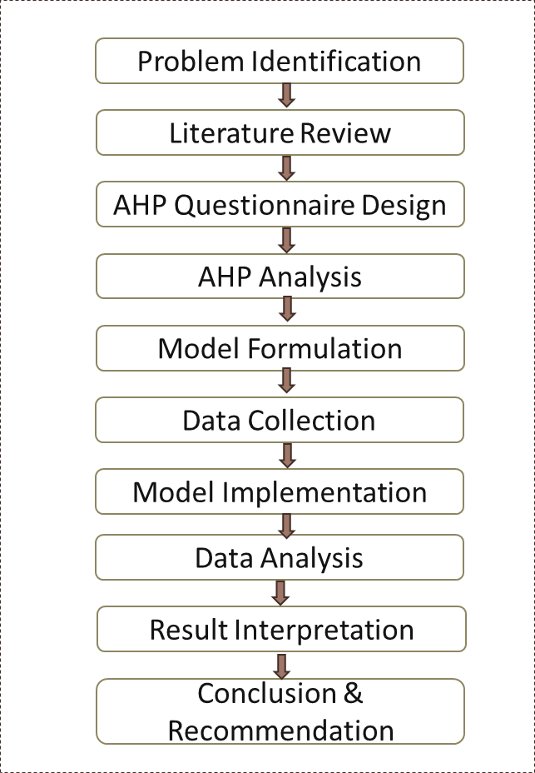
METHODOLOGY FRAMEWORK

Slide 8
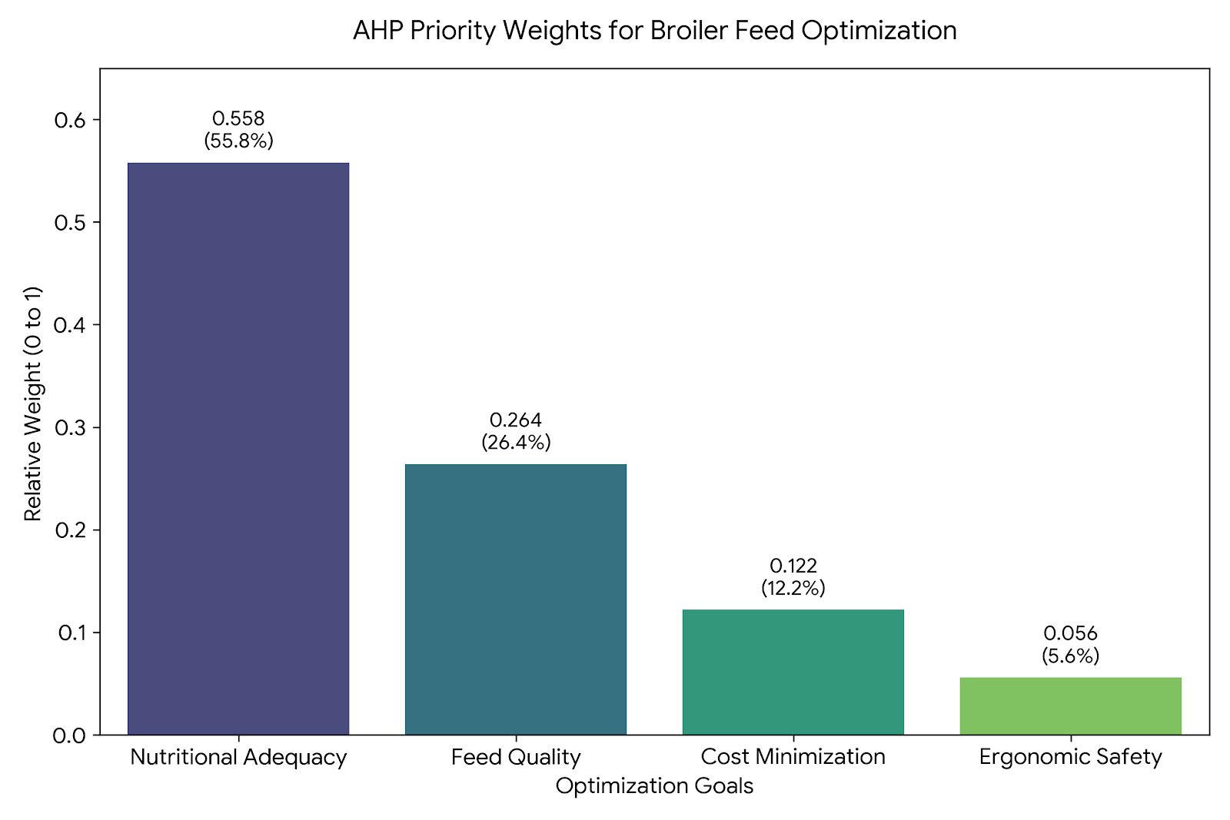



Determining Priority Weights (AHP)
Expert-Driven Hierarchy: The priority structure is developed using the Analytic Hierarchy Process (AHP) based on industry expert feedback.
Pairwise Comparison: Experts compare goals (e.g., Bird Health vs. Cost Savings) using Saaty’s 1–9 scale.
Consistency Verification: The model computes a Consistency Ratio (CR); judgments are accepted only if CR ≤ 0.10.
Weight Application: The validated weights (Cₛ) are incorporated as coefficients in the objective function to minimize weighted deviations.

Slide 9




Formulation Variables
System Variables
Description | Variable
Mass of specific ingredients included in the batch | x(i,s)
Steam temperature during processing | T(s)
Added moisture during conditioning | M(s)
Particle size of feed material | P(s)
Throughput rate of feed production | R(s)
Final packaged feed bag weight | W(s)
Degree of goal satisfaction | λ(p)
Satisfaction value bounded between 0 and 1 | 0<λ(p)<1

Slide 10
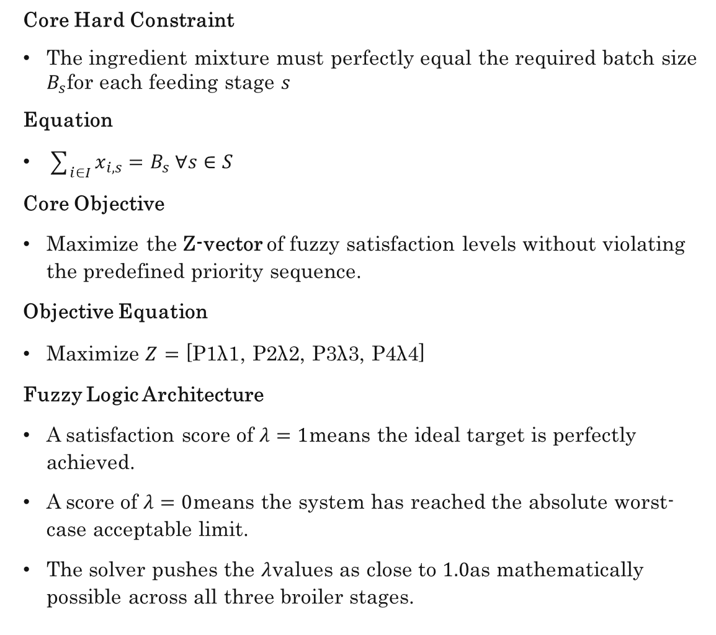
The Lexicographic Objective Function
Core Hard Constraint
The ingredient mixture must perfectly equal the required batch size $B_{s}$for each feeding stage $s$
Equation
$\sum_{i∈I}{x_{i,s}}=B_{s} ∀s∈S$
Core Objective
Maximize the Z-vector of fuzzy satisfaction levels without violating the predefined priority sequence.
Objective Equation
$\text{Maximize} Z=\text{[}\text{P}\text{1​}\text{λ}\text{1​}\text{,} \text{P}\text{2​}\text{λ}\text{2​}\text{,} \text{P}\text{3​}\text{λ}\text{3​}\text{,} \text{P}\text{4​}\text{λ}\text{4​}\text{]}$
Fuzzy Logic Architecture
A satisfaction score of $λ=1$means the ideal target is perfectly achieved.
A score of $λ=0$means the system has reached the absolute worst-case acceptable limit.
The solver pushes the $λ$values as close to $1.0$as mathematically possible across all three broiler stages.

Slide 11
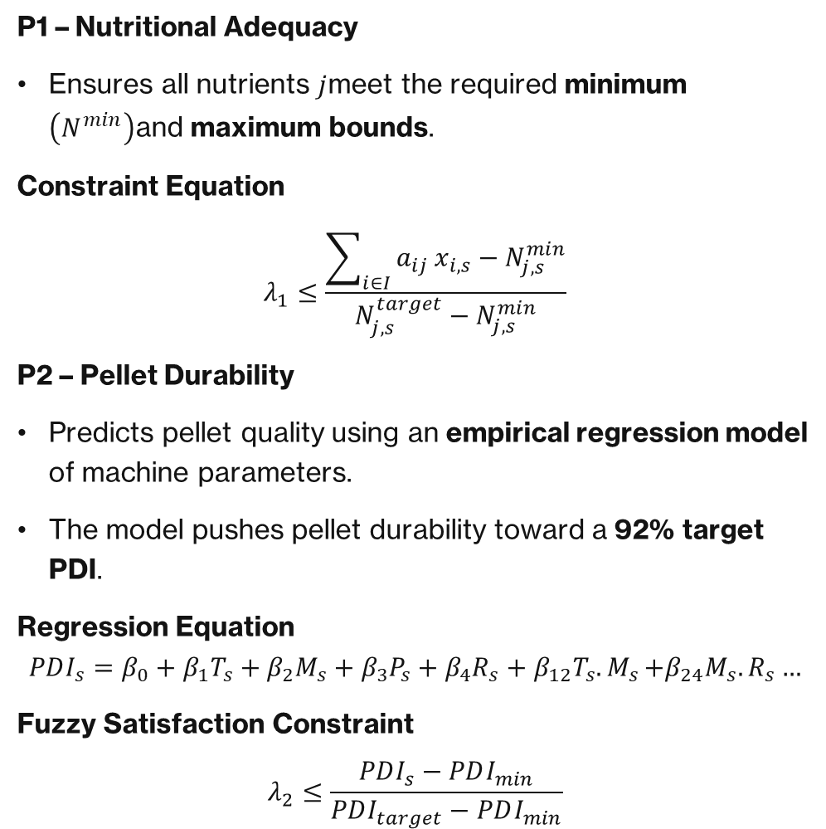


Optimizing Nutrition and Pellet Quality
P1​ – Nutritional Adequacy
Ensures all nutrients $j$meet the required minimum $\left(N^{min}\right)$and maximum bounds.
Constraint Equation
$$λ_{1}≤\frac{\sum_{i∈I}{a_{ij}}x_{i,s}−N_{j,s}^{min}}{N_{j,s}^{target}−N_{j,s}^{min}}$$
P2​ – Pellet Durability
Predicts pellet quality using an empirical regression model of machine parameters.
The model pushes pellet durability toward a 92% target PDI.
Regression Equation
$$PDI_{s}=β_{0}+β_{1}T_{s}+β_{2}M_{s}+β_{3}P_{s}+β_{4}R_{s}+β_{12}T_{s}{.M}_{s}+β_{24}M_{s}{.R}_{s}…$$
Fuzzy Satisfaction Constraint
$$λ_{2}≤\frac{PDI_{s}−PDI_{min}}{PDI_{target}−PDI_{min}}$$

Slide 12
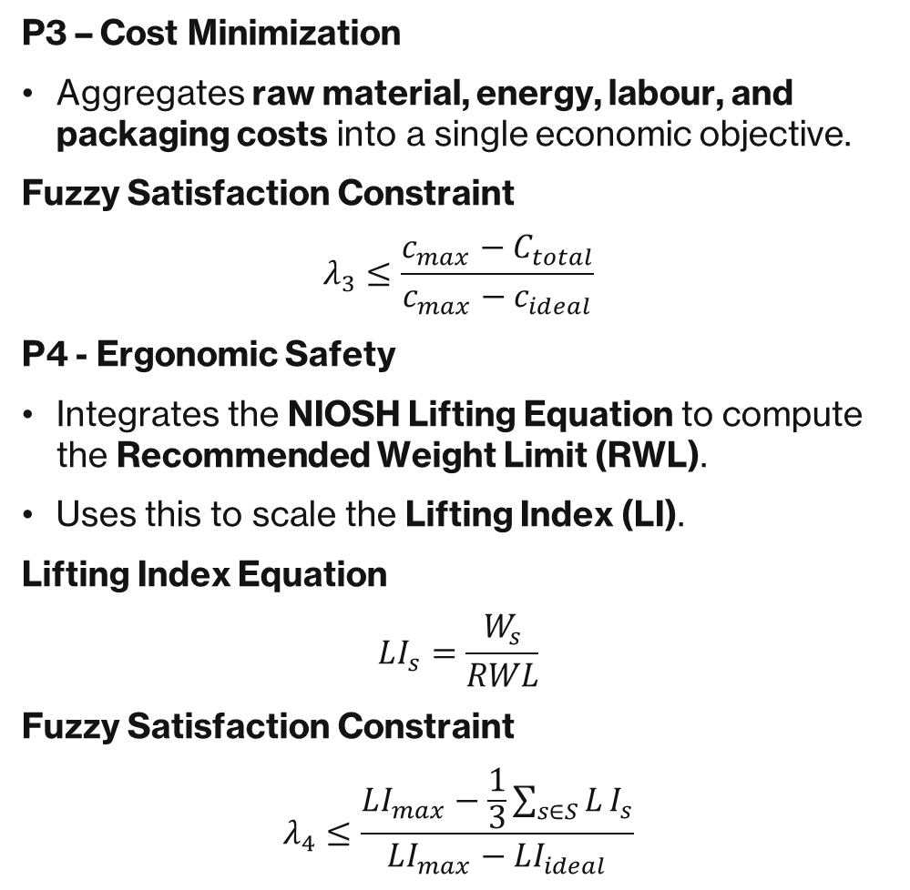




Cost and Ergonomics
P3​ – Cost Minimization
Aggregates raw material, energy, labour, and packaging costs into a single economic objective.
Fuzzy Satisfaction Constraint
$$λ_{3}≤\frac{c_{max}−C_{total}}{c_{max}−c_{ideal}}$$
P4 - Ergonomic Safety
Integrates the NIOSH Lifting Equation to compute the Recommended Weight Limit (RWL).
Uses this to scale the Lifting Index (LI).
Lifting Index Equation
$$LI_{s}=\frac{W_{s}}{RWL}$$
Fuzzy Satisfaction Constraint
$$λ_{4}≤\frac{LI_{max}−\frac{1}{3}\sum_{s∈S}{L}I_{s}}{LI_{max}−LI_{ideal}}$$

Slide 13
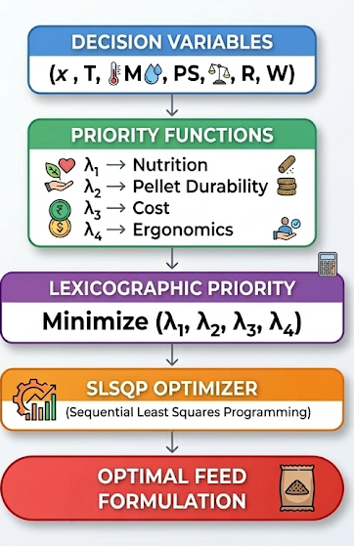
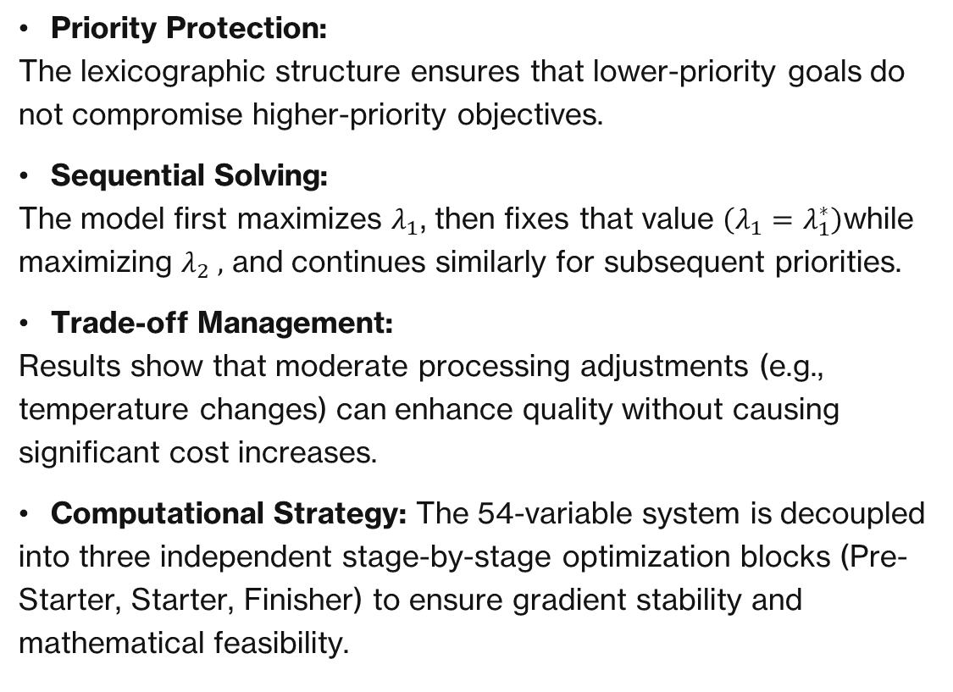
THE model sequence
Priority Protection: The lexicographic structure ensures that lower-priority goals do not compromise higher-priority objectives.
Sequential Solving: The model first maximizes $λ_{1}$, then fixes that value $\left(λ_{1}=λ_{1}^{∗}\right)$while maximizing $λ_{2} ,$ and continues similarly for subsequent priorities.
Trade-off Management: Results show that moderate processing adjustments (e.g., temperature changes) can enhance quality without causing significant cost increases.
Computational Strategy: The 54-variable system is decoupled into three independent stage-by-stage optimization blocks (Pre-Starter, Starter, Finisher) to ensure gradient stability and mathematical feasibility.

Slide 14
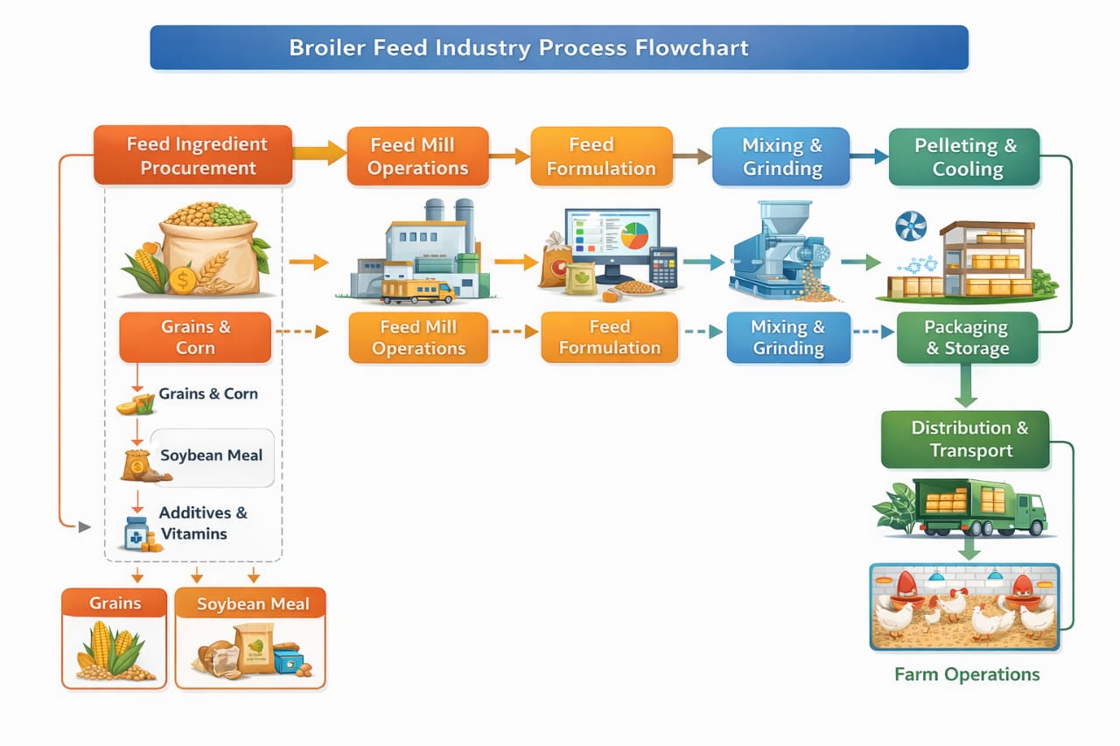
Case Study implementation: XYZ Feed Company

Slide 15
Broiler feed industry process flow
The process begins with procurement of raw materials such as maize, soybean meal, vitamins, and additives.
The ingredients are ground and mixed to form a uniform feed mixture.
The mixture undergoes conditioning and pelleting, followed by cooling, packaging, and storage before distribution to farms.
During the observation, workers were found manually handling heavy feed bags, which may lead to ergonomic issues such as back and shoulder strain.
Maintaining consistent pellet quality and controlling production cost are also key challenges in the feed manufacturing process.

Slide 16
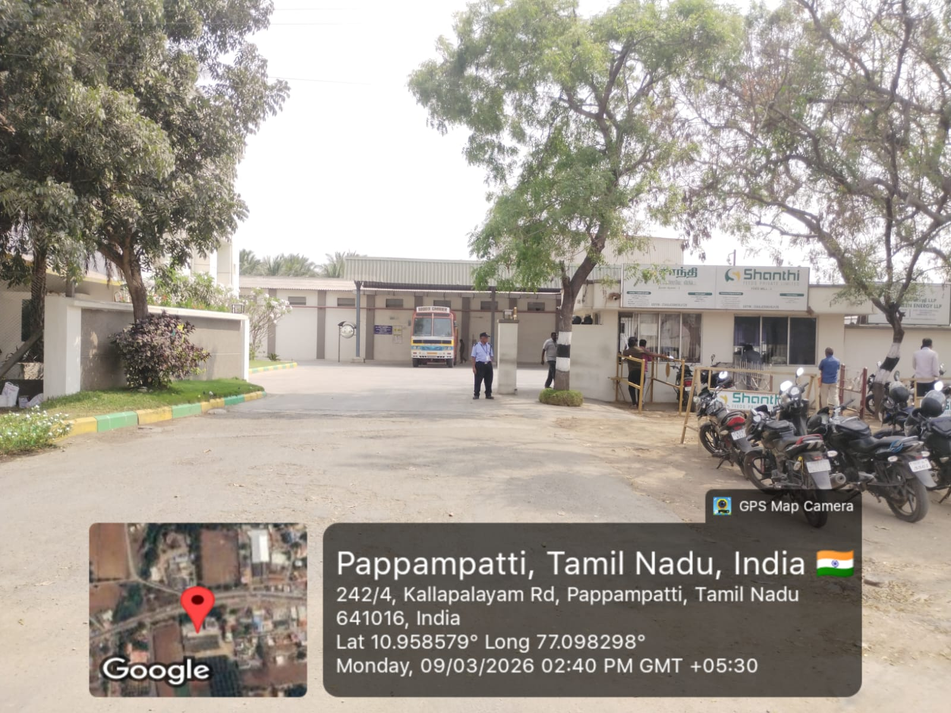
Case Study Implementation: XYZ Feed
Company
To populate the LFGP model, we extracted live manufacturing data across four operational domains:
Nutritional Baselines: Mapped the strict min/max limits for 9 key nutrients (Energy, Protein, Fat, Amino Acids, etc.) across 3 growth stages.
Process & Quality Data: Captured empirical regression data over multiple shifts mapping Temperature (75-85°C), Moisture, and Particle Size to the Pellet Durability Index (PDI).
Cost Accounting: Quantified raw material prices (13 ingredients) alongside specific utility coefficients (steam, water, grinding electricity, and labor).
Ergonomic measurements: Measured physical worker tasks (Horizontal/Vertical reaches, frequency) at the packaging line to calculate the NIOSH Recommended Weight Limit (RWL).

Slide 17
DATA COLLECTION
https://ergonomic-insight-lab.lovable.app/
BROILER FEED DATA

Slide 18
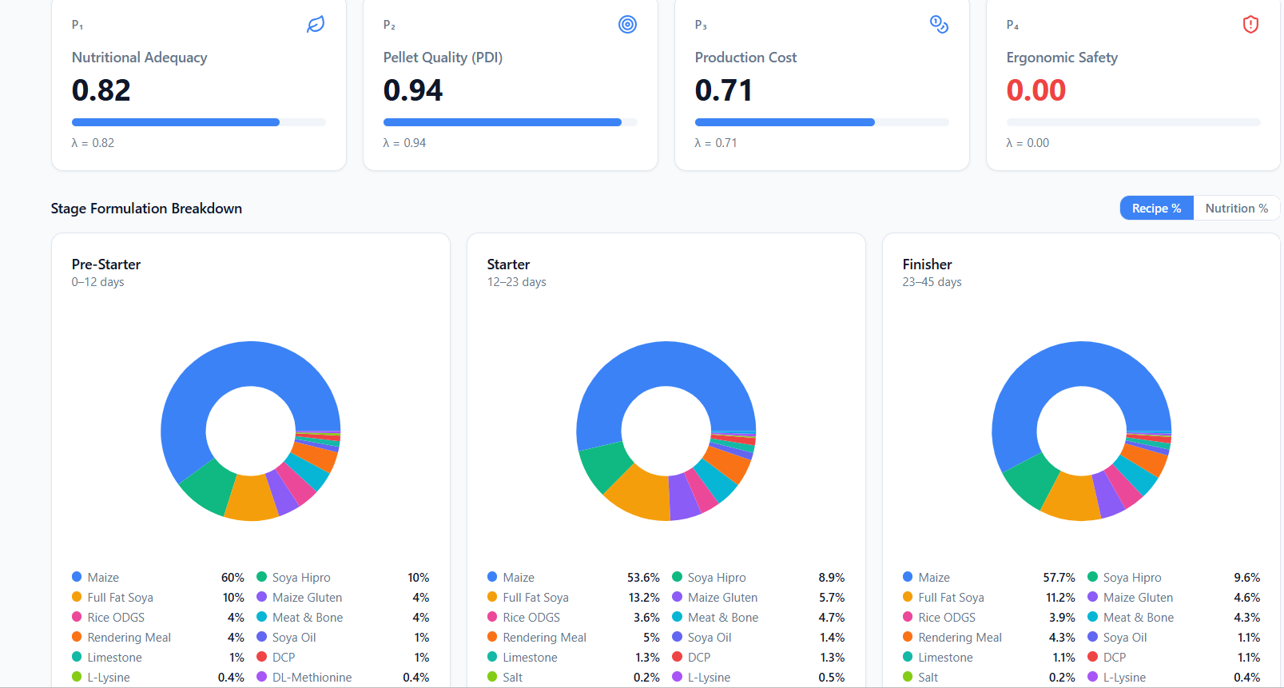

SATISFACTION LEVEL AND FEED METRICS
The feed formulation achieves good pellet quality (94%) and adequate nutrition (82%), showing the model maintains proper feed performance and nutrient balance.
Production cost is moderately optimized (71%) but ergonomic safety is not satisfied (0%), indicating that worker handling conditions still need improvement.

Slide 19
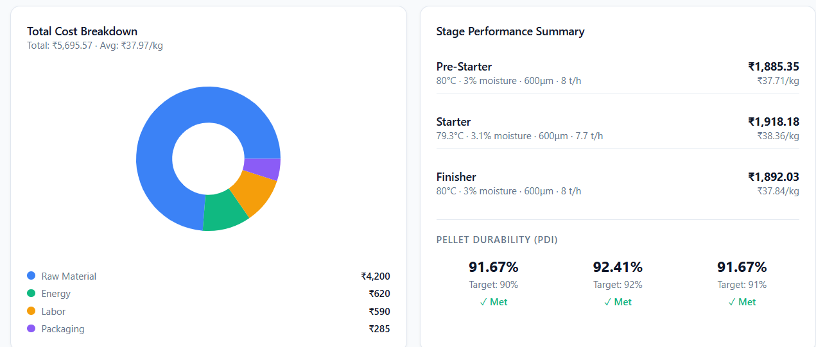
COST AND PROCESS METRICS
Raw material cost dominates the total cost, while energy, labor, and packaging contribute smaller portions.
Pellet durability targets are achieved in all stages, indicating good feed quality and stable processing conditions.

Slide 20
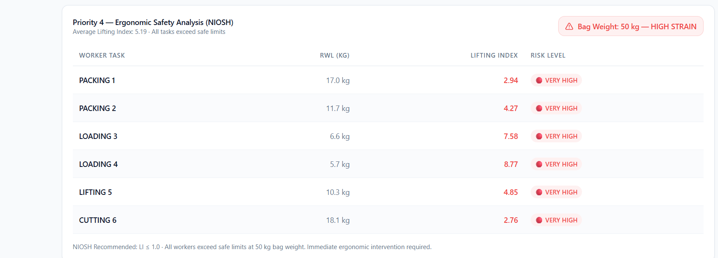
ERGONOMIC ANALYSIS
All tasks involving the 50 kg bags are classified as "VERY HIGH" risk, as their Lifting Index values (ranging from 2.76 to 8.77) far exceed the safe NIOSH limit of 1.0
The data indicates a critical safety violation that requires immediate ergonomic intervention to prevent worker injury and reduce extreme physical strain.

Slide 21
RECOMMENDATION
(from analysis)
Ergonomics (Bag Handling) : Reduce manual lifting strain by optimizing bag weight and improving workstation layout, such as adjusting pallet height or using simple lifting aids.
Nutrition & Cost : Improve formulation flexibility by allowing small adjustments in filler or micro ingredients, helping maintain nutritional targets while controlling ingredient cost.
Processing Quality : Maintain stable operating parameters (temperature, moisture, throughput) to consistently achieve high pellet durability and efficient production.

Slide 22
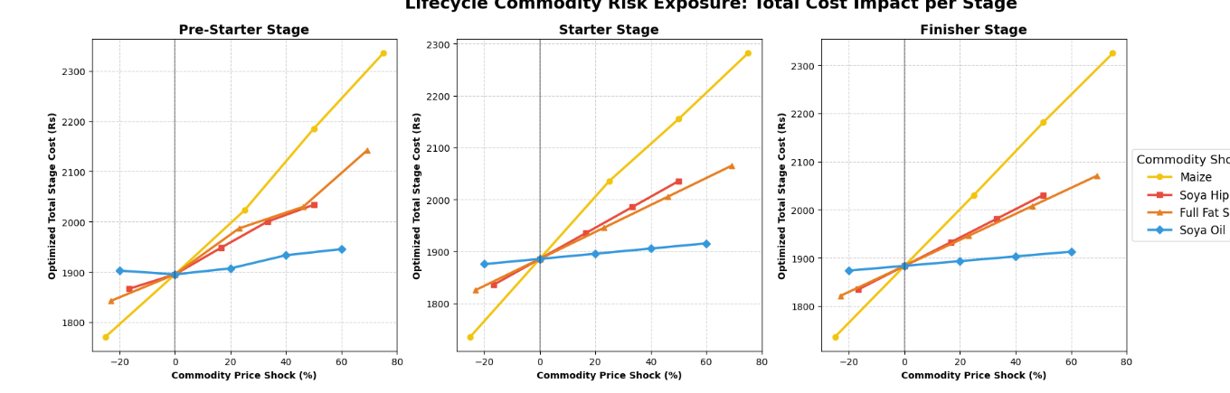
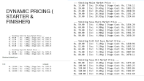
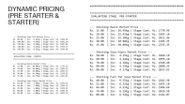
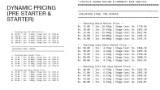
Dynamic Shadow Pricing
The Static Limitation: Traditional feed matrices fail during supply chain disruptions. We stress-tested the LFGP architecture using Parametric Cost Sweeps.
The Protein Shock (Soya Hipro): Causes a massive cost spike in the Pre-Starter phase, but the impact flattens in the Finisher phase.
The Volume Driver (Maize): Creates a steep, unavoidable baseline cost surge across all three stages due to high energy demands.
Autonomous Budget Defense: The LFGP algorithm dynamically substitutes overpriced ingredients (e.g., pivoting to Meat & Bone Meal) to protect the profit margin without violating biological limits.

Slide 23
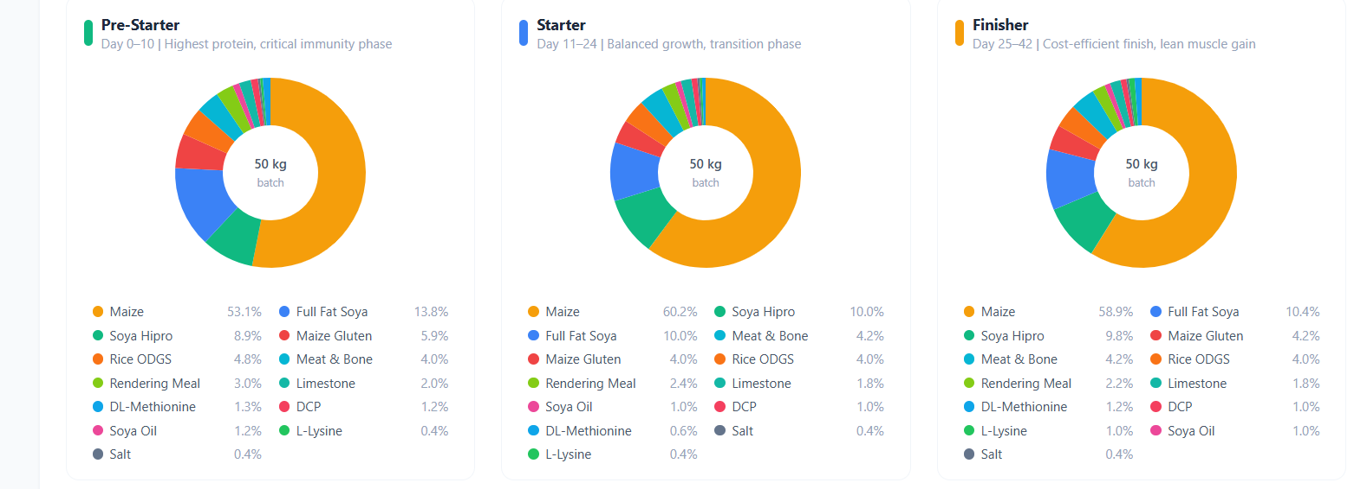
Key Insights &
Business Impact
Maize: Identified as the highest cost driver with a strong impact on total costs across all stages.
Protein Sources (Soya variants): Inclusion levels remain stable, as they are tightly constrained by nutritional requirements.
Soya Oil: Exhibits low sensitivity, resulting in a minor impact on overall costs.
Model Behavior
The system automatically rebalances formulations in response to price fluctuations to maintain efficiency.
Business Value:
Risk-Aware Procurement: Enables more informed, strategic purchasing.
Hedging Strategy: Identifies critical commodities that require hedging to protect margins.
Cost Optimization: Supports robust cost management even under uncertain market conditions.

Slide 24
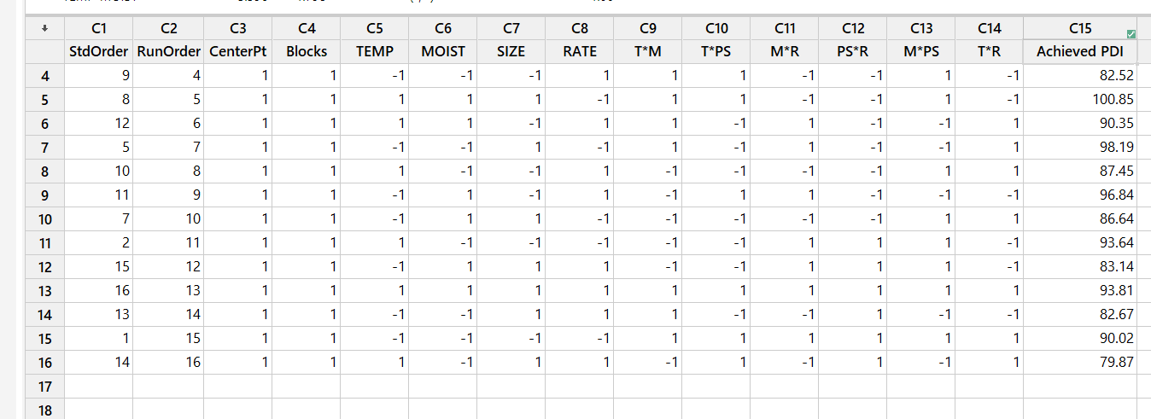


PDI FACTORIAL ANALYSIS
The Linear Limitation: Standard First-Order regression assumes machine dials (Temperature, Moisture, Particle Size, Rate) operate completely independently. This violates the real-world thermodynamics of steam conditioning.
Statistical Engineering Matrix: Upgraded the data architecture to a Two-Level, Four-Factor (2^4) Full Factorial Design using Minitab, executing a 16-run saturated matrix to map the exact response surface of the pellet mill.
Algorithmic Integration: Extracted a comprehensive 16-term hybrid regression equation that captures pure main effects alongside complex 2-way, 3 way and 4-way physical interactions.

Slide 25
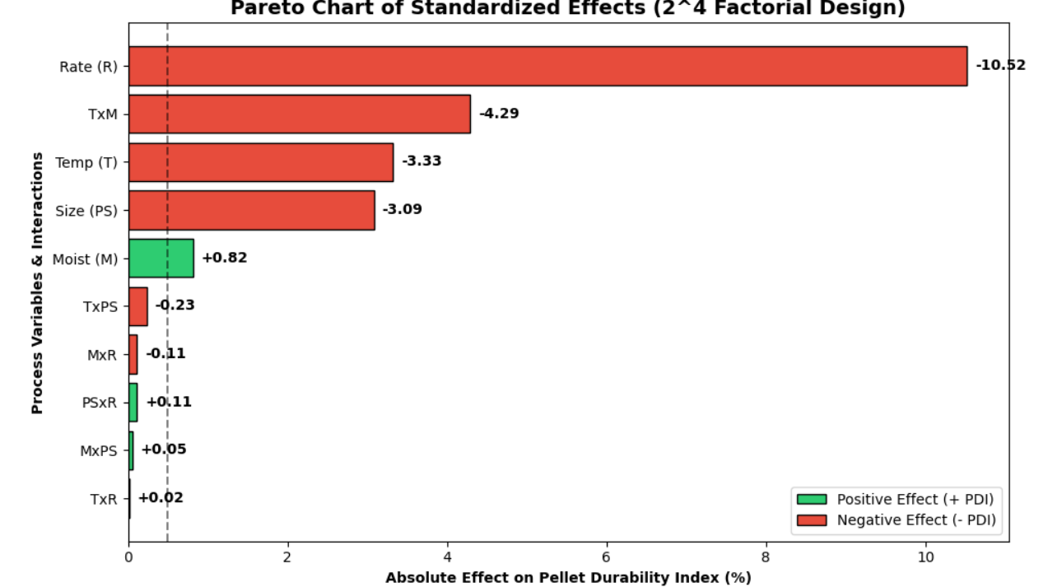
PARETO ANALYSIS
Throughput (D) is the Primary Bottleneck: Pushing the mill to maximum speed violently degrades durability due to insufficient steam retention time.
Speed & Moisture Clash (BD Interaction): High production rates combined with high moisture over-lubricate the die, causing feed to slip without binding.
The 3-Way Collision (ABC Interaction): Steam conditioning (Heat + Water) completely fails if the particle size is ground too coarse to absorb it.
.

Slide 26
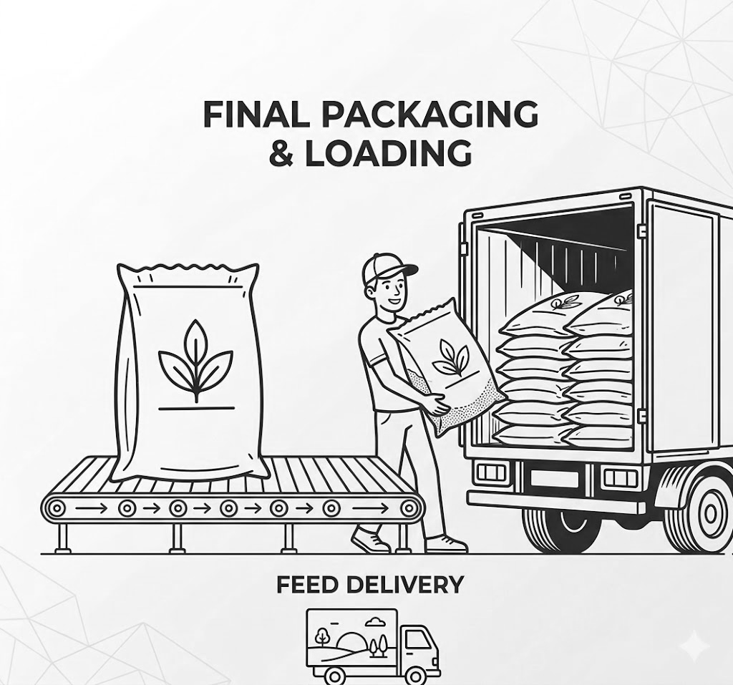
ERGONOMIC INTERVENTION
Intervention 1: Eliminate the Twist (Packing Line)
Fix: Install a 90-degree curved gravity roller conveyor
Impact: Reduces Asymmetry Angle (A) to 0°, pushing the AM multiplier to 1.0 and increasing safe lifting capacity by ~30%
Intervention 2: Eliminate the Reach (Loading Line)
Fix: Introduce spring-leveling scissor lift tables
Impact: Locks the Vertical Height (V) at waist-level (75 cm) for the entire shift, securing a perfect VM of 1.0
Intervention 3: The Market Reality (Vacuum Assist)
Fix: If the market demands a 50 kg bag, install a pneumatic vacuum tube lifter
Impact: Bypasses the NIOSH lifting equation entirely, absorbing 100% of the load without sacrificing packaging budgets

Slide 27
ERGONOMIC COST ANALYSIS
Baseline: 50 kg Bag (Manual)
Volume: 2,000 bags/day (40 bags/pallet)
Time: 22.5 sec/bag → 15 mins / pallet
Labor (OpEx): 4 workers → ₹12.0L / year
The Mathematical Trap: 40 kg Bag (LFGP Optimized)
Volume Penalty: 2,500 bags/day (25% volume increase)
Time: 21.6 sec/bag → 18 mins / pallet (Slower)
Labor : 4.5 (5) workers needed → ₹13.5L / year (More expensive)
The Engineering Fix: Semi-Automated (Conveyors + Lifts)
CapEx: ₹4.5L (Gravity Conveyor + 2x Scissor Lifts)
Time: 12 sec/bag → 10 mins / pallet (33% Faster)
Labor (OpEx): 2.6 (3) workers → ₹8.0L / year (₹5.5L Savings)

Slide 28
ERGONOMIC COST ANALYSIS
The NIOSH Equation: Recommended Weight Limit (RWL) = 23 kg × VM × DM × AM
Why Manual Fails (40kg & 50kg)
The Flaw: Reaching low (VM = 0.71) and twisting (AM = 0.71)
Resulting RWL: Only ~7 to 9 kg
Risk Score: Lifting 50kg with a 7kg limit → LI = 7.0 (Catastrophic)
Why Semi-Automation Succeeds (LI = 0.9)
The Fix: Lifts lock height at waist (VM = 1.0). Conveyors stop twisting (AM = 1.0).
New RWL: Perfect geometry restores the maximum 23 kg limit
Execution: A mandatory 2-person lift splits the 40kg bag (20 kg per worker)
Final Score: 20 kg / 23 kg = 0.9 (Safe Zone)

Slide 29
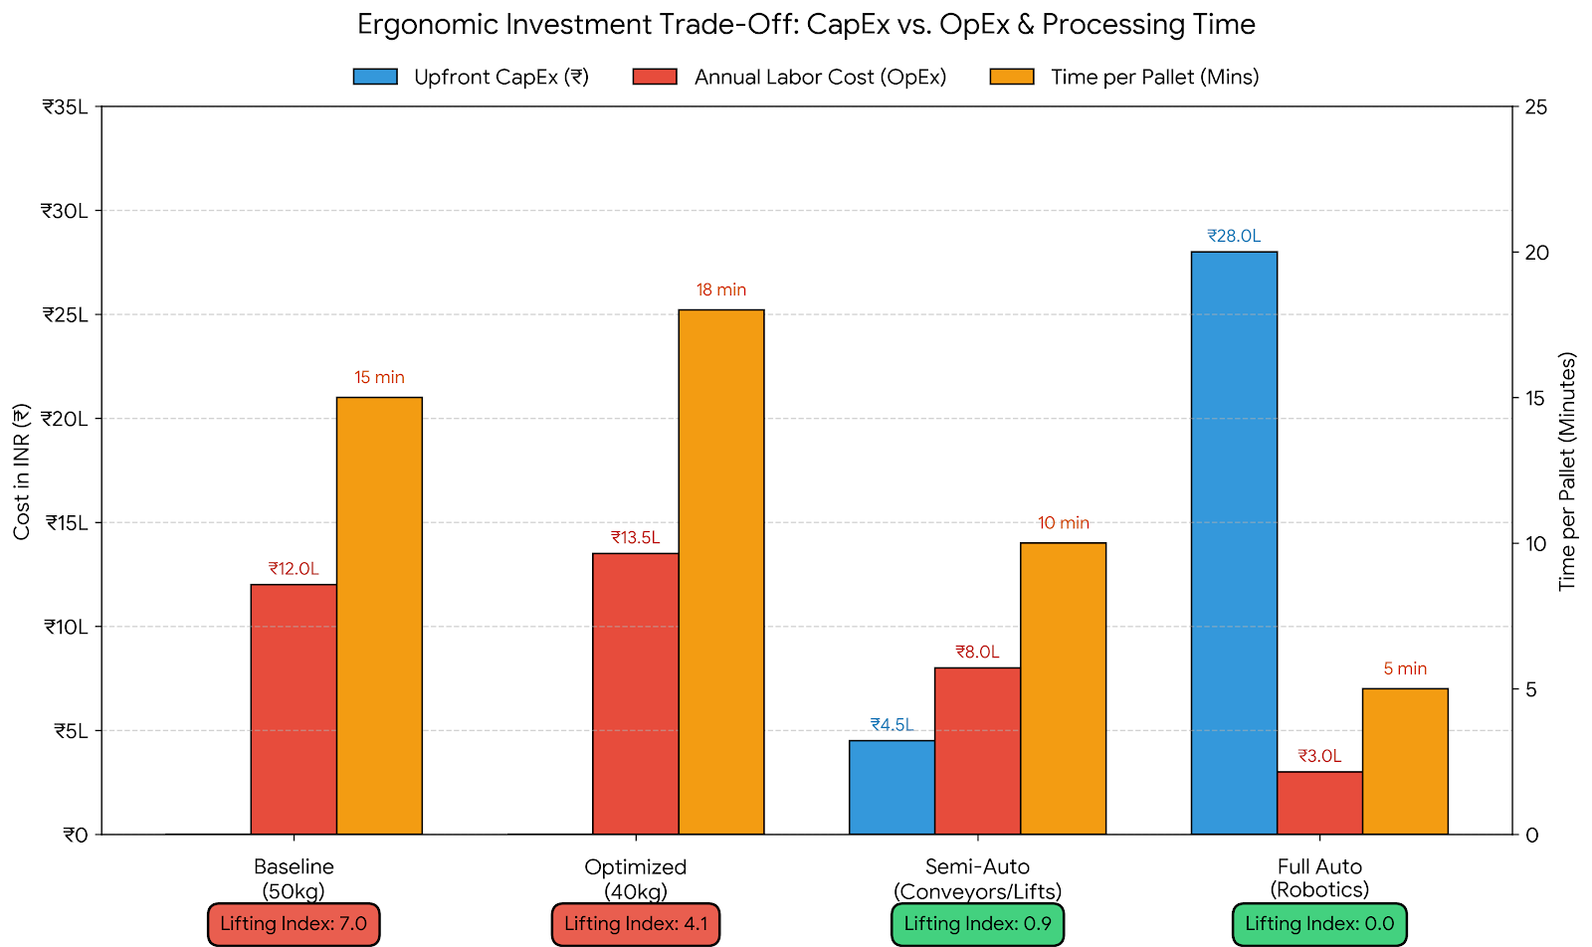
ERGONOMIC INTERVENTION
The Mathematical Limit: Our solver dropping the bag to 40kg actually increased labor time (red line), as workers must pack more bags per ton. Ergonomics improved slightly, but not into the safe zone.
The Sweet Spot (Semi-Automation): Investing in Scissor Lifts and Conveyors requires moderate upfront Capital Expenditure (blue bars), but it drastically drops both processing time and annual labor costs.
The Geometric Fix: Most importantly, this moderate investment drops the Lifting Index (LI) from a catastrophic 7.0 down to a safe 0.9 by locking the vertical reach at waist height.

Slide 30
Recommendation
Process & Quality Control:
Bottleneck: Throughput → higher rates reduce pellet durability
Synergy: Align steam conditioning (heat + moisture) with particle size
to avoid rapid PDI descent.
Target: Sustain 91% PDI under optimized parameters
Economic Resilience :
Maize Hedging: Primary cost driver → hedge against volatility
Dynamic Substitution: LFGP-based ingredient switching (e.g., MBM)
during price spikes
Procurement: Shift to sensitivity-driven, risk-aware sourcing
Ergonomic Interventions:
Eliminate Twist: 90° conveyors → reduce asymmetry, ↑ lifting safety
Neutral Lifting: Scissor lifts maintain ~75 cm waist height
Load Handling: Vacuum lifters for 50 kg bags → meet NIOSH standards

Slide 31
CONCLUSION
Systems Engineering Transformation : This project transforms broiler feed manufacturing from a static cost model into a dynamic, integrated factory system. Using Lexicographic Fuzzy Goal Programming (LFGP), it aligns nutrition, cost, machine physics, and worker safety within a single multi-objective optimization framework.
Analytical Validation & Strategic Impact : Advanced diagnostics validate real-world performance:
DoE (2⁴ factorial) reveals key thermodynamic bottlenecks (e.g., Temperature–Moisture interaction)
Shadow Pricing enables adaptive profit protection under supply shocks
Ergonomic ROI confirms that safety requires physical redesign (scissor lifts, conveyors), not just weight reduction
Result: Ultimately, this research provides a simulated decision-support framework, proving that feed manufacturability, cost efficiency, and workforce safety can be successfully optimized within a unified model.

Slide 32
REFERENCES
1. You et al. (2025) You, J., Tulpan, D., Krziyzek, C., & Ellis, J. L. (2025). Prediction of pellet durability index in a commercial feed mill using multiple linear regression with variable selection and dimensionality reduction. Journal of Animal Science, 103, skaf021. https://doi.org/10.1093/jas/skaf021
2. Khan et al. (2021) Khan, M. F., Pervez, A., Modibbo, U. M., Chauhan, J., & Ali, I. (2021). Flexible fuzzy goal programming approach in optimal mix of power generation for socio-economic sustainability: A case study. Sustainability, 13(15), 8256. https://doi.org/10.3390/su13158256
3. Rashid et al. (2020) Rashid, N. R. M., Lip, N. M., Salim, F. F. M., Kamazan, N. F., & Latib, S. N. A. M. (2020). Feeding blend optimization for livestock by using goal programming approach. Malaysian Journal of Computing, 5(2), 495-503.
4. Putri et al. (2020) Putri, N. T., [Other Authors], & [Other Authors]. (2020). Ergonomics evaluation of manual material handling activities in the section of feeding laying hens at poultry farm. IOP Conference Series: Materials Science and Engineering, 1003(1), 012074. https://doi.org/10.1088/1757-899X/1003/1/012074

Slide 33
REFERENCES
5. Mallick et al. (2020) Mallick, P., Muduli, K., Biswal, J. N., & Pumwa, J. (2020). Broiler poultry feed cost optimization using linear programming technique. Journal of Operations and Strategic Planning, 3(1), 31-57. https://doi.org/10.1177/2516600X19896910
6. Tanhaie & Nahavandi (2017) Tanhaie, F., & Nahavandi, N. (2017). Solving product mix problem in multiple constraints environment using goal programming. Journal of Industrial Engineering and Management Studies, 4(1), 1-12. https://doi.org/10.22116/JIEMS.2017.51960
7. Vakili et al. (2015) Vakili, R., Torshizi, M. E., Yaghobzadeh, M. M., & Khadivi, H. (2015). Determination of chemical composition and physical feed quality with different processing parameters in broiler feed mill factories. Biological Forum – An International Journal, 7(1), 1098-1103.
8. Pal & Moitra (2004) Pal, B. B., & Moitra, B. N. (2004). Using fuzzy goal programming for long range production planning in agricultural systems. Indian Journal of Agricultural Economics, 59(1), 88-103.
9. Solano-Blanco et al. (2023) [Your Example Reference] Solano-Blanco, A. L., González, J. E., & Medaglia, A. L. (2023). Production planning decisions in the broiler chicken supply chain with growth uncertainty. Operations Research Perspectives, 10, 100273. https://doi.org/10.1016/j.orp.2023.100273

Slide 34
Nomenclature
Indices and Sets
Symbol | Description
I | Set of available feed ingredients, indexed by i
J | Set of nutritional parameters, indexed by j
S | Set of broiler feeding stages where S = {Pre-Starter, Starter, Finisher}, indexed by s
P | Set of priority levels in the lexicographic structure where P = {1,2,3,4}, indexed by p

Slide 35
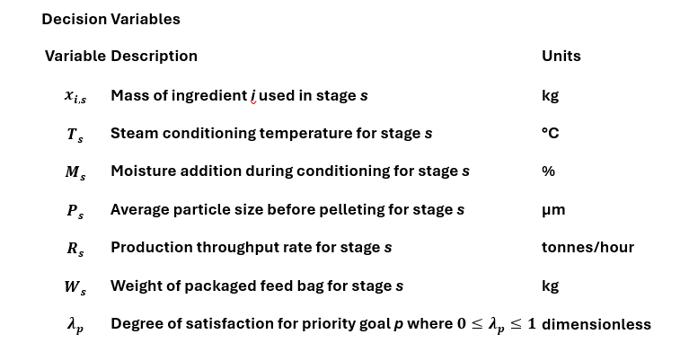
Nomenclature

Slide 36
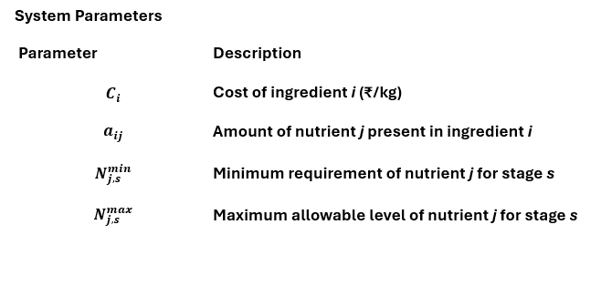
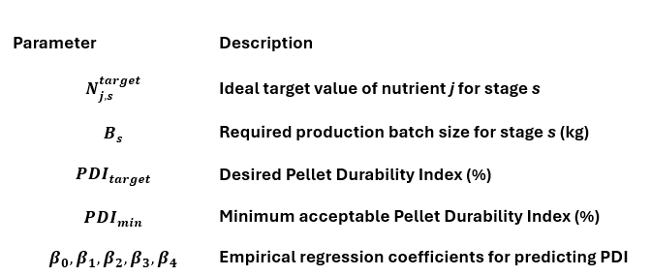
Nomenclature

Slide 37
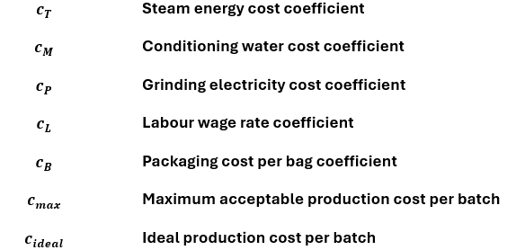
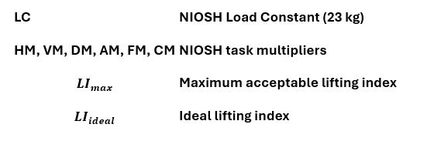
Nomenclature

Slide 38



Mathematical Formulation
The proposed model is formulated as a Lexicographic Fuzzy Goal Programming (LFGP) problem. The primary objective is to maximize the fuzzy satisfaction levels in a strict priority hierarchy:
Lexicographic Objective Function
Maximize
SYSTEM CONSTRAINTS
Batch Mass Balance Constraint
This constraint ensures that the ingredient mixture equals the required batch size for each broiler feeding stage.

Slide 39



Variable Bounds
Ingredient Variable Bounds
Temperature Bounds
Moisture Addition Bounds
Particle Size Bounds

Slide 40



Variable Bounds
Production Rate Bounds
Packaging Weight Bounds
Fuzzy Satisfaction Bounds

Slide 41


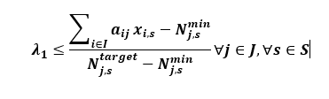
Priority Level 1: Nutritional Adequacy and Safety
Minimum Nutrient Requirement
Maximum Nutrient Limit
Fuzzy Satisfaction Membership for Nutrition
The overall nutrition satisfaction $λ_{1}$is the minimum across all nutrients and stages.

Slide 42


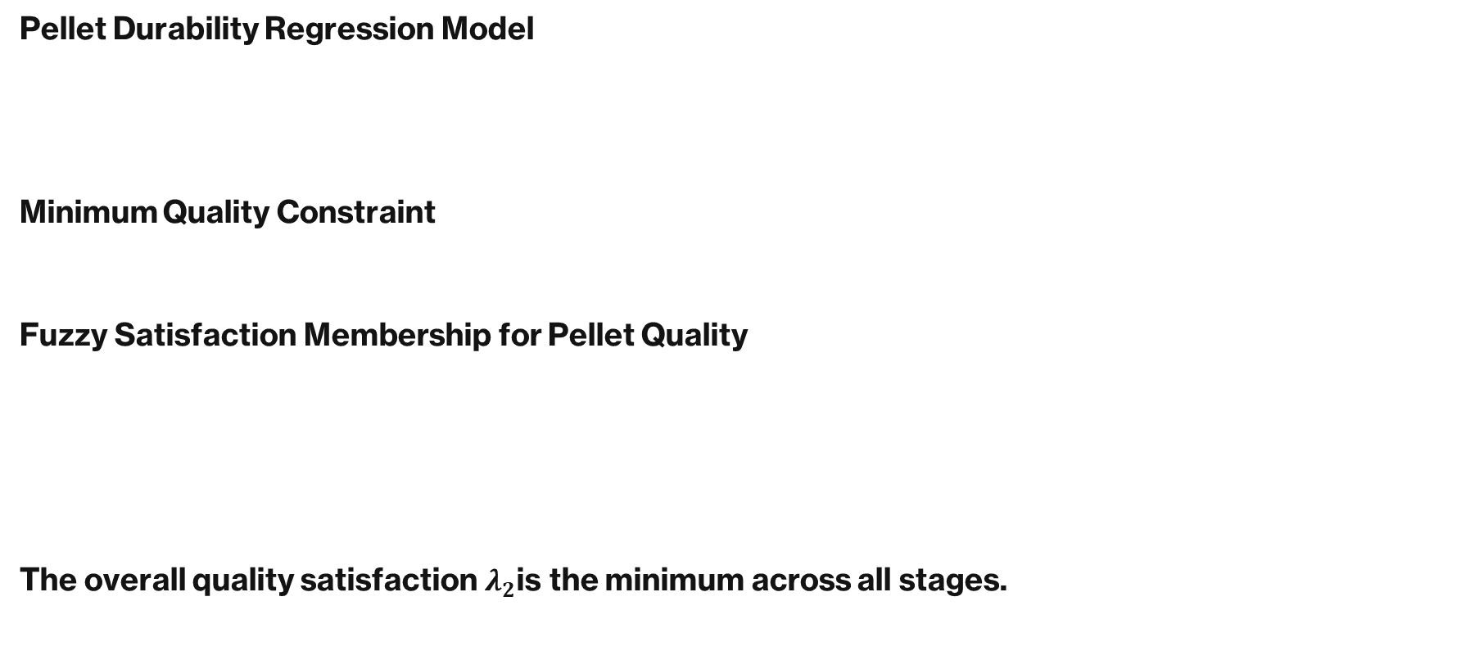
PRIORITY LEVEL2: PELLET DURABILITY OPTIMIZATION
Pellet Durability Regression Model
Minimum Quality Constraint
Fuzzy Satisfaction Membership for Pellet Quality
The overall quality satisfaction $λ_{2}$is the minimum across all stages.

Slide 43
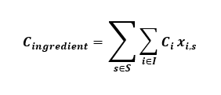



PRIORITY LEVEL 3 : PRODUCTION COST OPTIMIZATION
Ingredient Cost
Processing Cost
Labour Cost
Packaging Cost

Slide 44

PRIORITY LEVEL 3 : PRODUCTION COST OPTIMIZATION
Total Production Cost
Fuzzy Satisfaction Membership for Cost

Slide 45



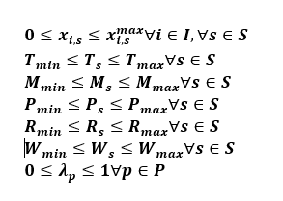
PRIORITY LEVEL 4 :ERGONOMIC SAFETY OPTIMIZATION
Recommended Weight Limit (NIOSH Equation)
Lifting Index
Fuzzy Satisfaction Membership for Ergonomic Safety
Variable Bounds

Slide 46
AHP QUESTIONNAIRE
1.Feed Cost vs Nutritional Requirement
2.Feed Cost vs Ingredient Availability
3.Feed Cost vs Feed Quality / Production Efficiency
4.Nutritional Requirement vs Ingredient Availability
5.Nutritional Requirement vs Feed Quality / Production Efficiency
5.Ingredient Availability vs Feed Quality / Production Efficiency

Slide 47
AHP QUESTIONNAIRE
The 6 Pairwise Comparison Questions
Question 1: Nutritional Adequacy vs. Feed Quality
When optimizing broiler feed production, which is more important: ensuring the Nutritional Adequacy & Safety (meeting biological nutrient targets) or maximizing Feed Quality (pellet durability and reducing fines)?
Scale (1-9): ______
Which one is favored? ______
Question 2: Nutritional Adequacy vs. Cost Minimization
When optimizing broiler feed production, which is more important: ensuring the Nutritional Adequacy & Safety or achieving Cost Minimization (reducing overall production and ingredient expenses)?
Scale (1-9): ______
Which one is favored? ______

Slide 48
AHP QUESTIONNAIRE
Question 3: Nutritional Adequacy vs. Ergonomic Safety
When optimizing broiler feed production, which is more important: ensuring the Nutritional Adequacy & Safety or prioritizing Ergonomic Safety (reducing lifting strain, cardiovascular load, and manual handling risks for workers)?
Scale (1-9): ______
Which one is favored? ______
Question 4: Feed Quality vs. Cost Minimization
When optimizing broiler feed production, which is more important: maximizing Feed Quality (optimizing processing parameters for better pellets) or achieving Cost Minimization?
Scale (1-9): ______
Which one is favored? ______

Slide 49
AHP QUESTIONNAIRE
Question 5: Feed Quality vs. Ergonomic Safety
When optimizing broiler feed production, which is more important: maximizing Feed Quality or prioritizing Ergonomic Safety (improving bagging weights and handling frequency)?
Scale (1-9): ______
Which one is favored? ______
Question 6: Cost Minimization vs. Ergonomic Safety
When optimizing broiler feed production, which is more important: achieving Cost Minimization or prioritizing Ergonomic Safety for the workers?
Scale (1-9): ______
Which one is favored? ______

Slide 50
AHP Priority Weight Calculation
Pairwise Comparison Matrix
Criteria | Nutrition | Quality | Cost | Ergonomics
Nutrition | 1 | 3 | 5 | 7
Quality | 1/3 | 1 | 3 | 5
Cost | 1/5 | 1/3 | 1 | 3
Ergonomics | 1/7 | 1/5 | 1/3 | 1

Slide 51
AHP Priority Weight Calculation
Normalized Matrix
Criteria | N | Q | C | E | Row Avg (Weight)
Nutrition | 0.597 | 0.662 | 0.536 | 0.438 | 0.558
Quality | 0.199 | 0.221 | 0.321 | 0.313 | 0.264
Cost | 0.119 | 0.073 | 0.107 | 0.188 | 0.122
Ergonomics | 0.085 | 0.044 | 0.036 | 0.063 | 0.056

Slide 52

AHP Priority Weight Calculation
Consistency Check
λmax​=4.08
$$CI=\frac{λ_{max}−n}{n−1}=0.0267$$
$$CR=\frac{CI}{RI}=0.0296$$

Slide 53
MINITAB ANALYSIS

Slide 54
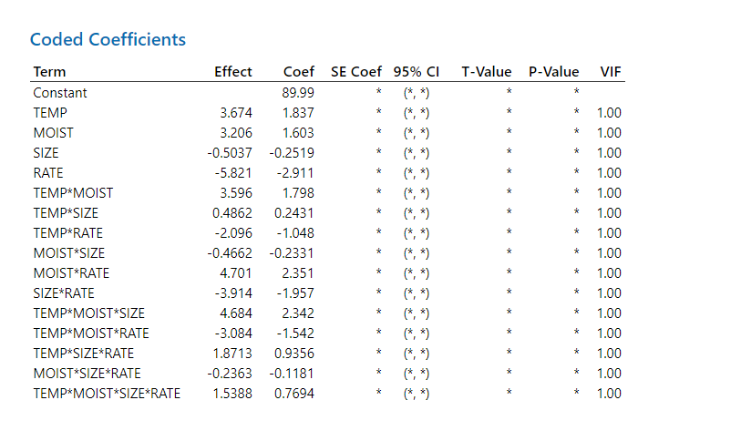

Slide 55
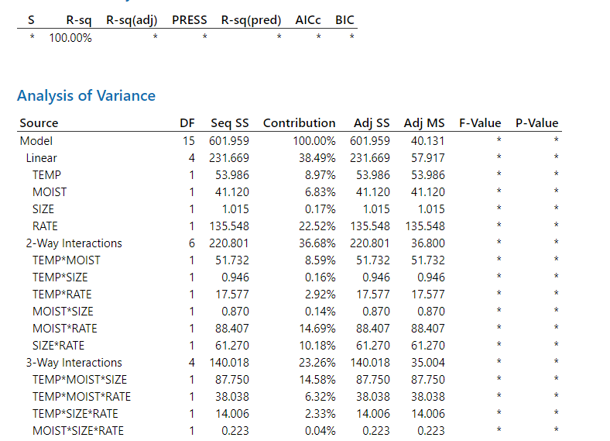

Slide 56
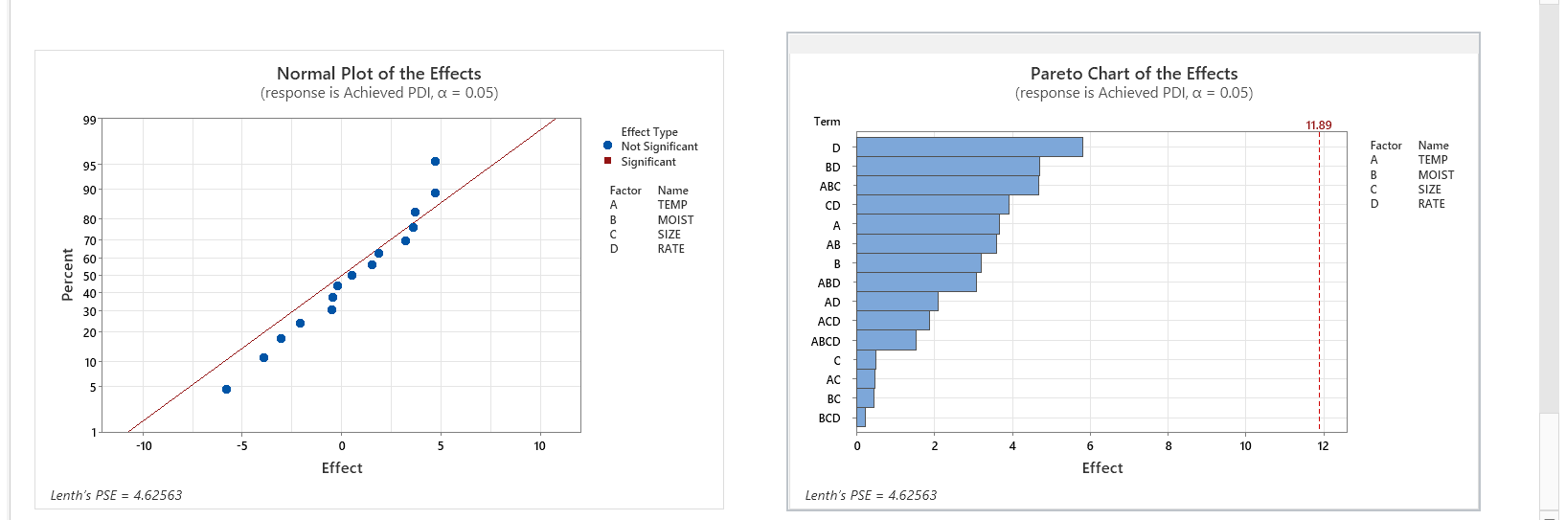

Slide 57
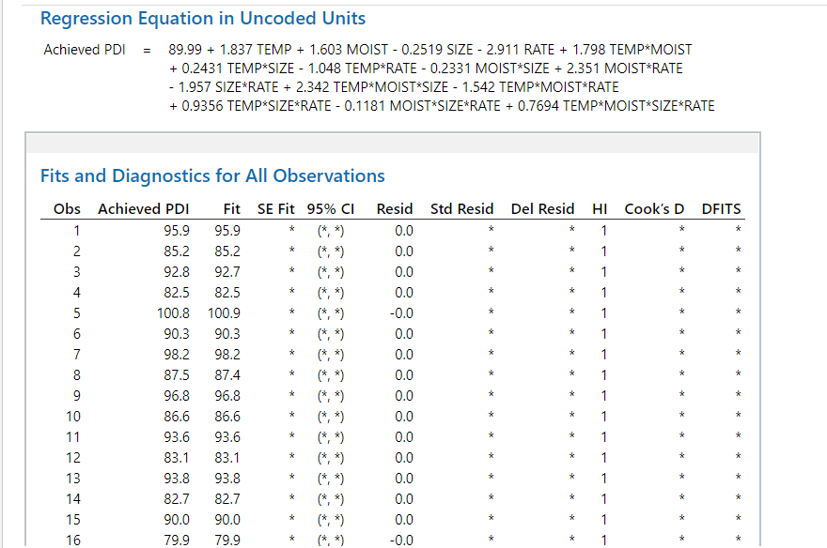

Slide 58
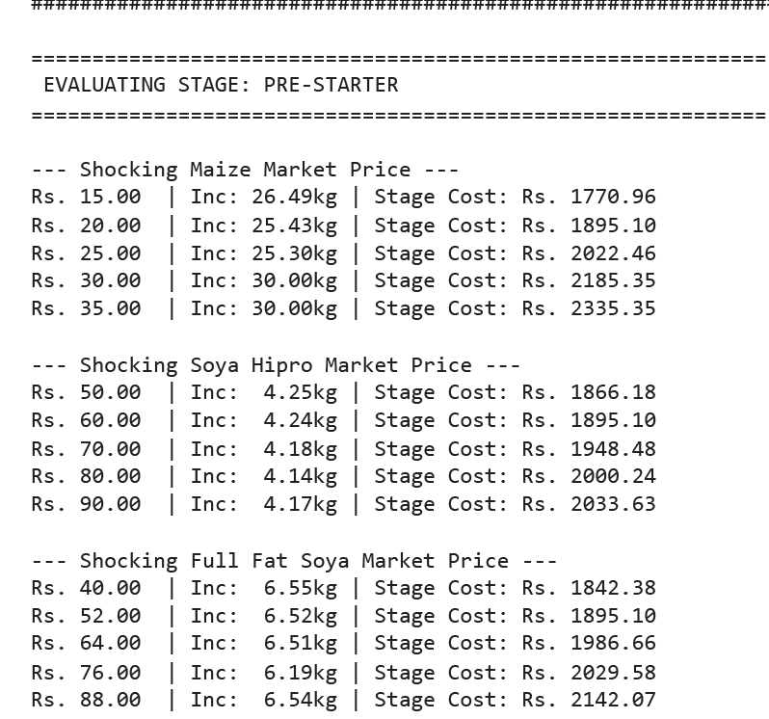
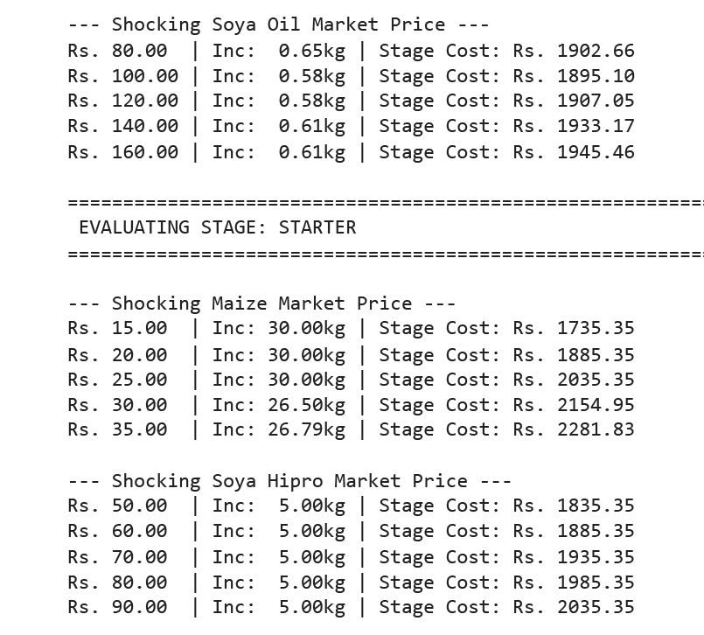
DYNAMIC PRICING (PRE STARTER & STARTER)

Slide 59
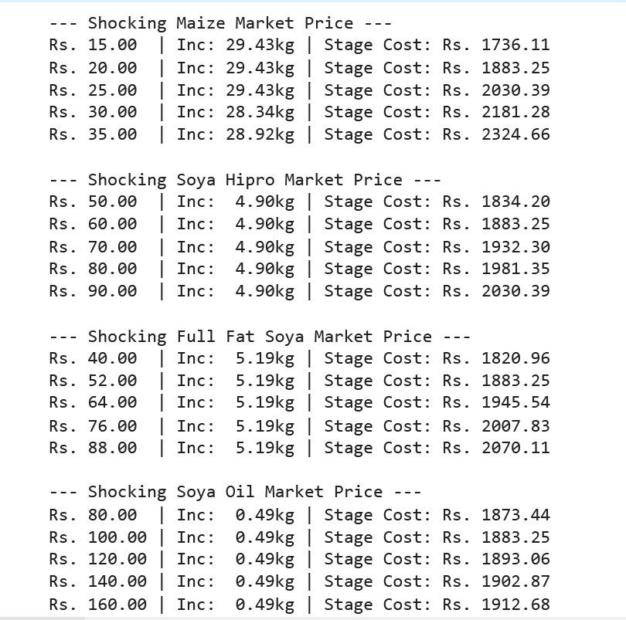
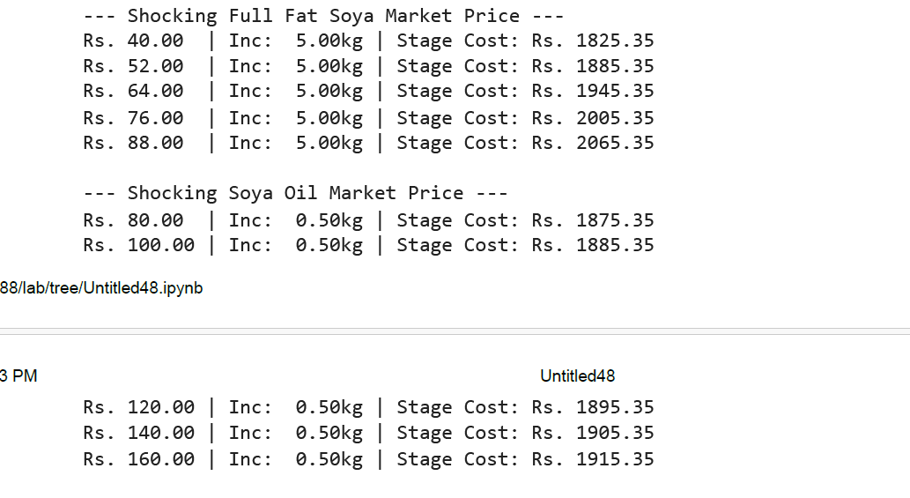
DYNAMIC PRICING ( STARTER & FINISHER)

Slide 60
